Slide 1

Netflix Dataset Analysis Exploring Netflix's 2021 Movie & TV Show Data

Slide 2

Introduction and Objective
Objective: Provide insights into Netflix's content library, focusing on popular trends, key statistics, and data exploration.
Data Source: Flixable’s Netflix dataset (from Kaggle)

Slide 3
Data Preparation
Tools Used:
Pandas
Seaborn
Matplotlib
Dataset Structure:
Rows: 8,807 Columns: 12
Key columns: Category, Title, Director, Cast, Country, Rating, Duration
Null Values: Notable missing data in 'Director', 'Cast', and 'Country' columns (visualized with a heatmap)

Slide 4
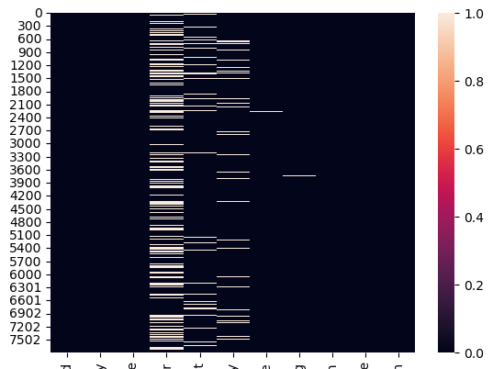
Data Cleaning
Duplicate Records: Removed to ensure data accuracy
Handling Null Values: Focus on columns with critical missing data, such as 'Director' and 'Cast'

Slide 5
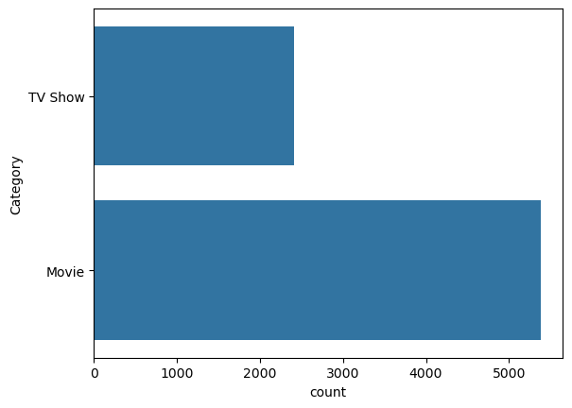
Insights: Category Distribution
Insight:
Movies dominate with 5,377 entries compared to 2,410 TV Shows

Slide 6
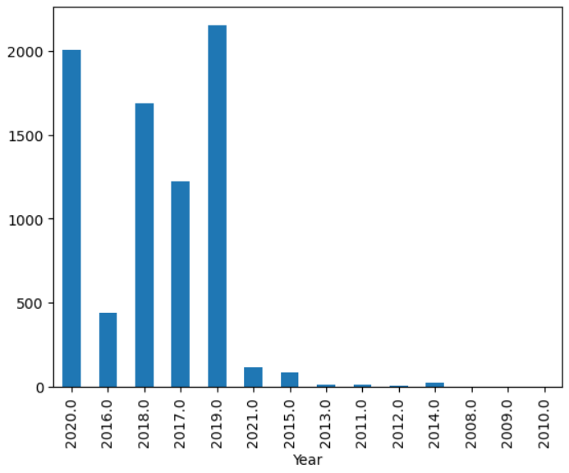
Insights: Release Year Analysis
Insight:
Majority of movies on platform are from 2017 to 2020, peaking in content from 2019

Slide 7
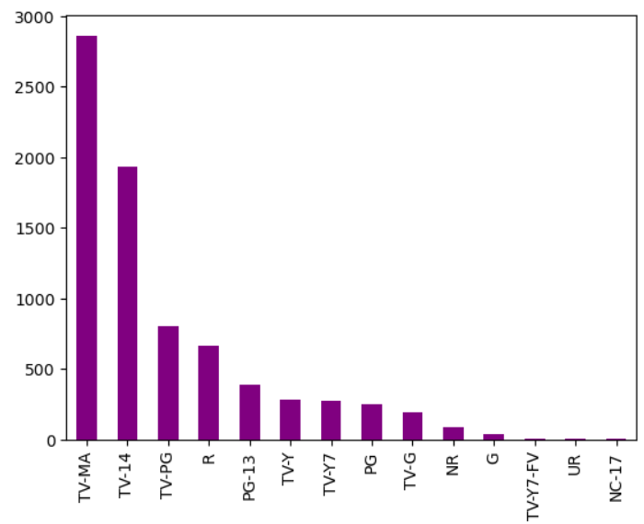
Insights: Content Rating Distribution
Insight:
TV-MA and TV-14 dominate the category mix

Slide 8
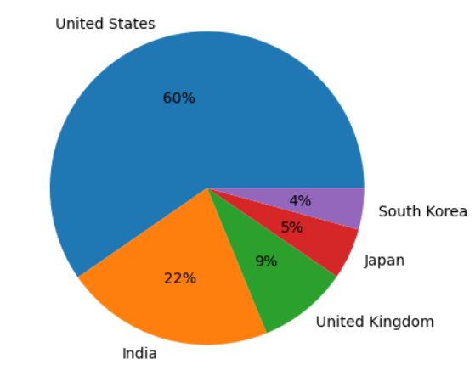
Insights: Content Rating Distribution
Insight:
The Top 5 content creators were the US, India, UK, Japan and South Korea

Slide 9
Conclusions & Next Steps
Conclusions
Next Steps
Content Release Frame: Majority of movies on platform are from 2017 to 2020, peaking in content from 2019
Category Trends: Movies dominate, but TV shows with multiple seasons likely drive longer engagement.
Mature Content: High presence of TV-MA and TV-14 ratings indicates a focus on mature and teen audiences.
Regional Focus: U.S., U.K., Japan, and South Korea are top content sources, showing geographic concentration.
Yearly Trends: Analyze post-2020 content shifts, including COVID-19’s impact.
User Engagement: Correlate popular categories/ratings with engagement metrics to identify viewer preferences.
Genre Focus: Dive deeper into mature-rated genres to refine content strategy.
Regional Analysis: Examine Netflix’s partnerships in top content-producing countries.
Format Exploration: Study reception of experimental formats (e.g., interactive films, multi-season series).

